Slide 1
Monopolistic Competition
AP Microeconomics

Slide 2
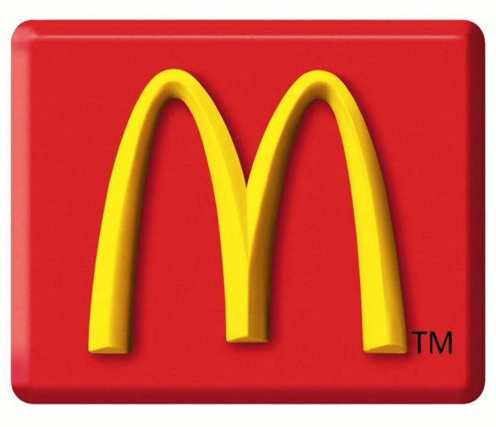
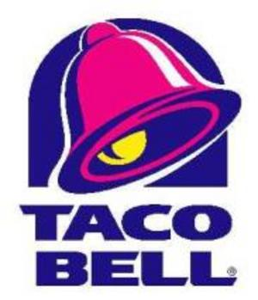
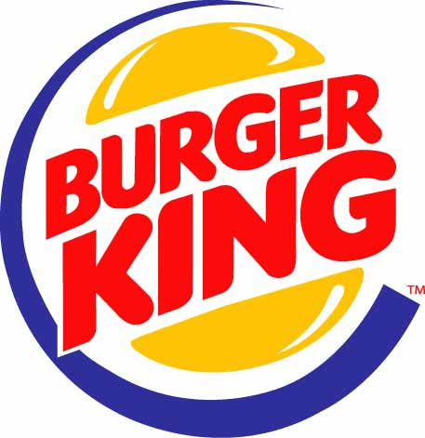
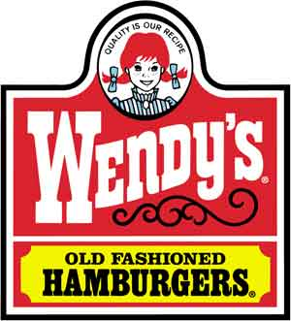
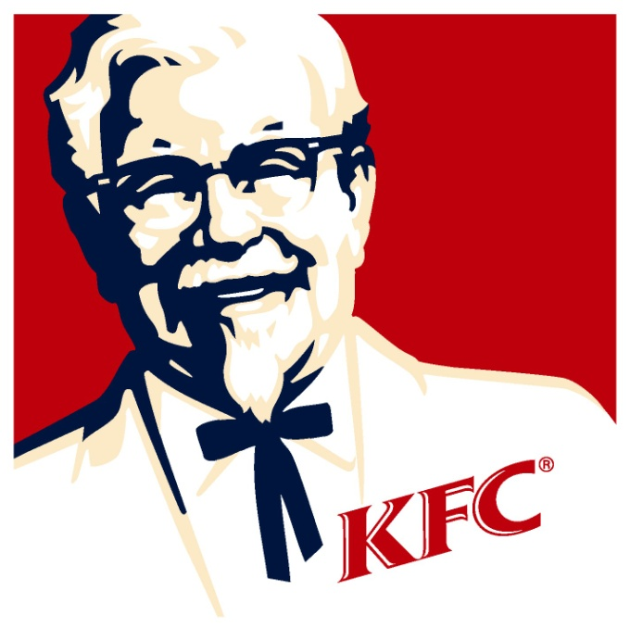
Fast Food

Slide 3
Monopolistic Competition
3 conditions
1. Large numbers of competing producers
2. Differentiated product
3. Free entry into and exit from the industry in the long run

Slide 4
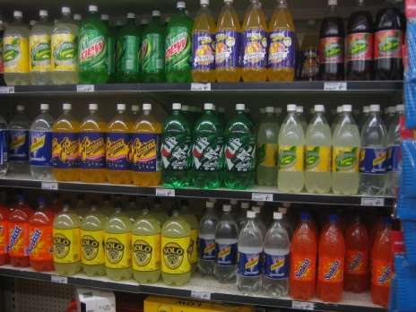
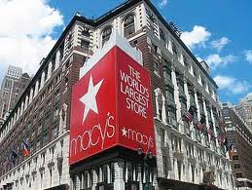
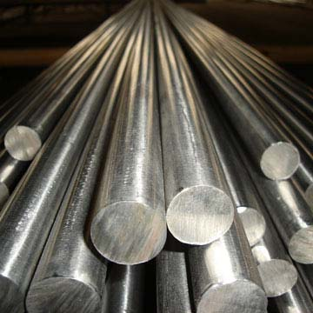
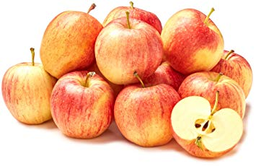
Check your understanding
Each of the following goods and services are differentiated products. Which are differentiated as a result of monopolistic competition and which are not? Explain your answers.
A. apples
B. soft drinks
C. department stores
D. steel

Slide 5
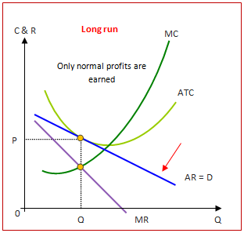
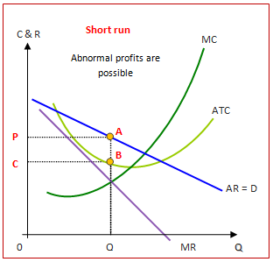
Graphs: Monopolistic Competition

Slide 6
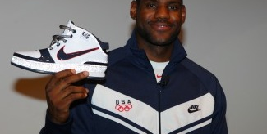
Lebron James
Adidas Sponsorship Offer: $50 Million
Reebok Sponsorship Offer: $75 Million
Nike Sponsorship Offer: $90 Million

Slide 7
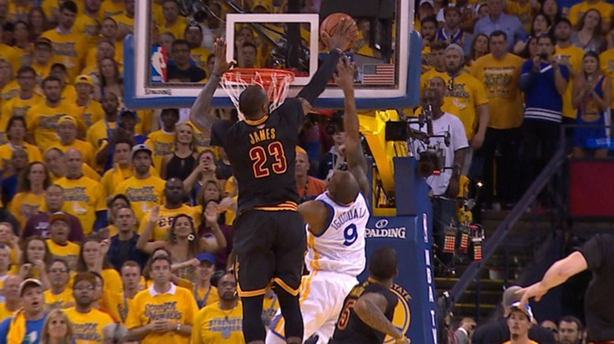
Answer the Following
Why would Nike spend $90 million on LeBron James?
How does this signing reflect a monopolistically competitive market?

Slide 8
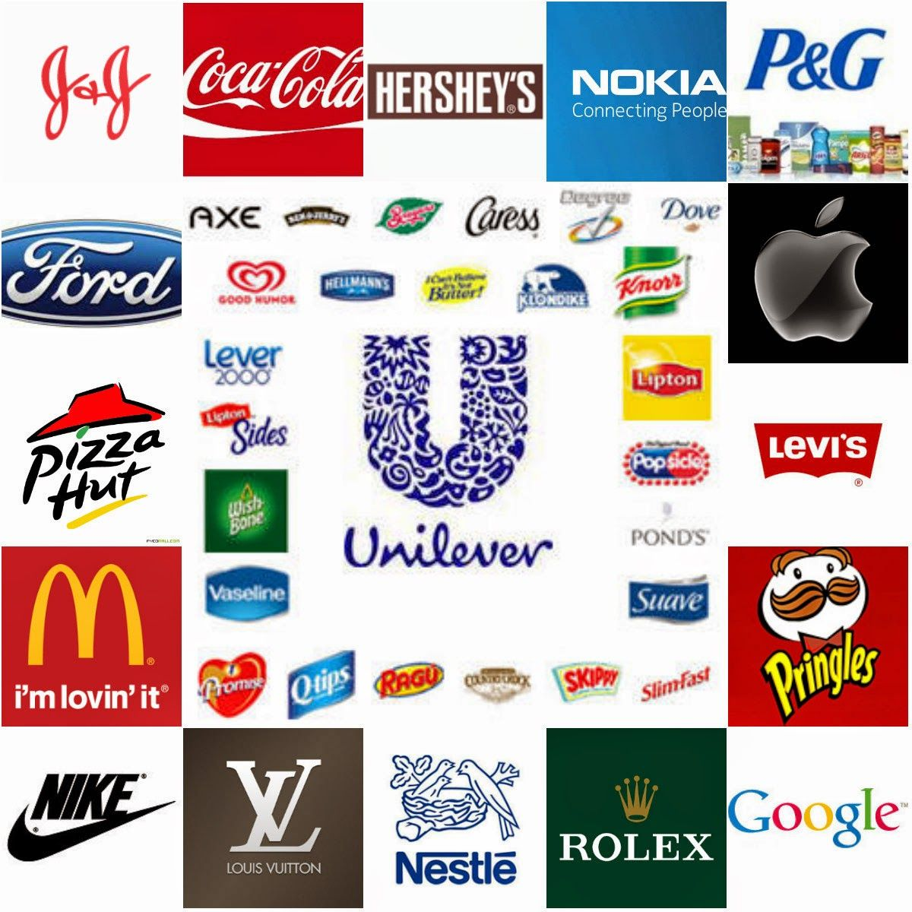
When having a successful brand name a barrier to entry?

